Slide 1


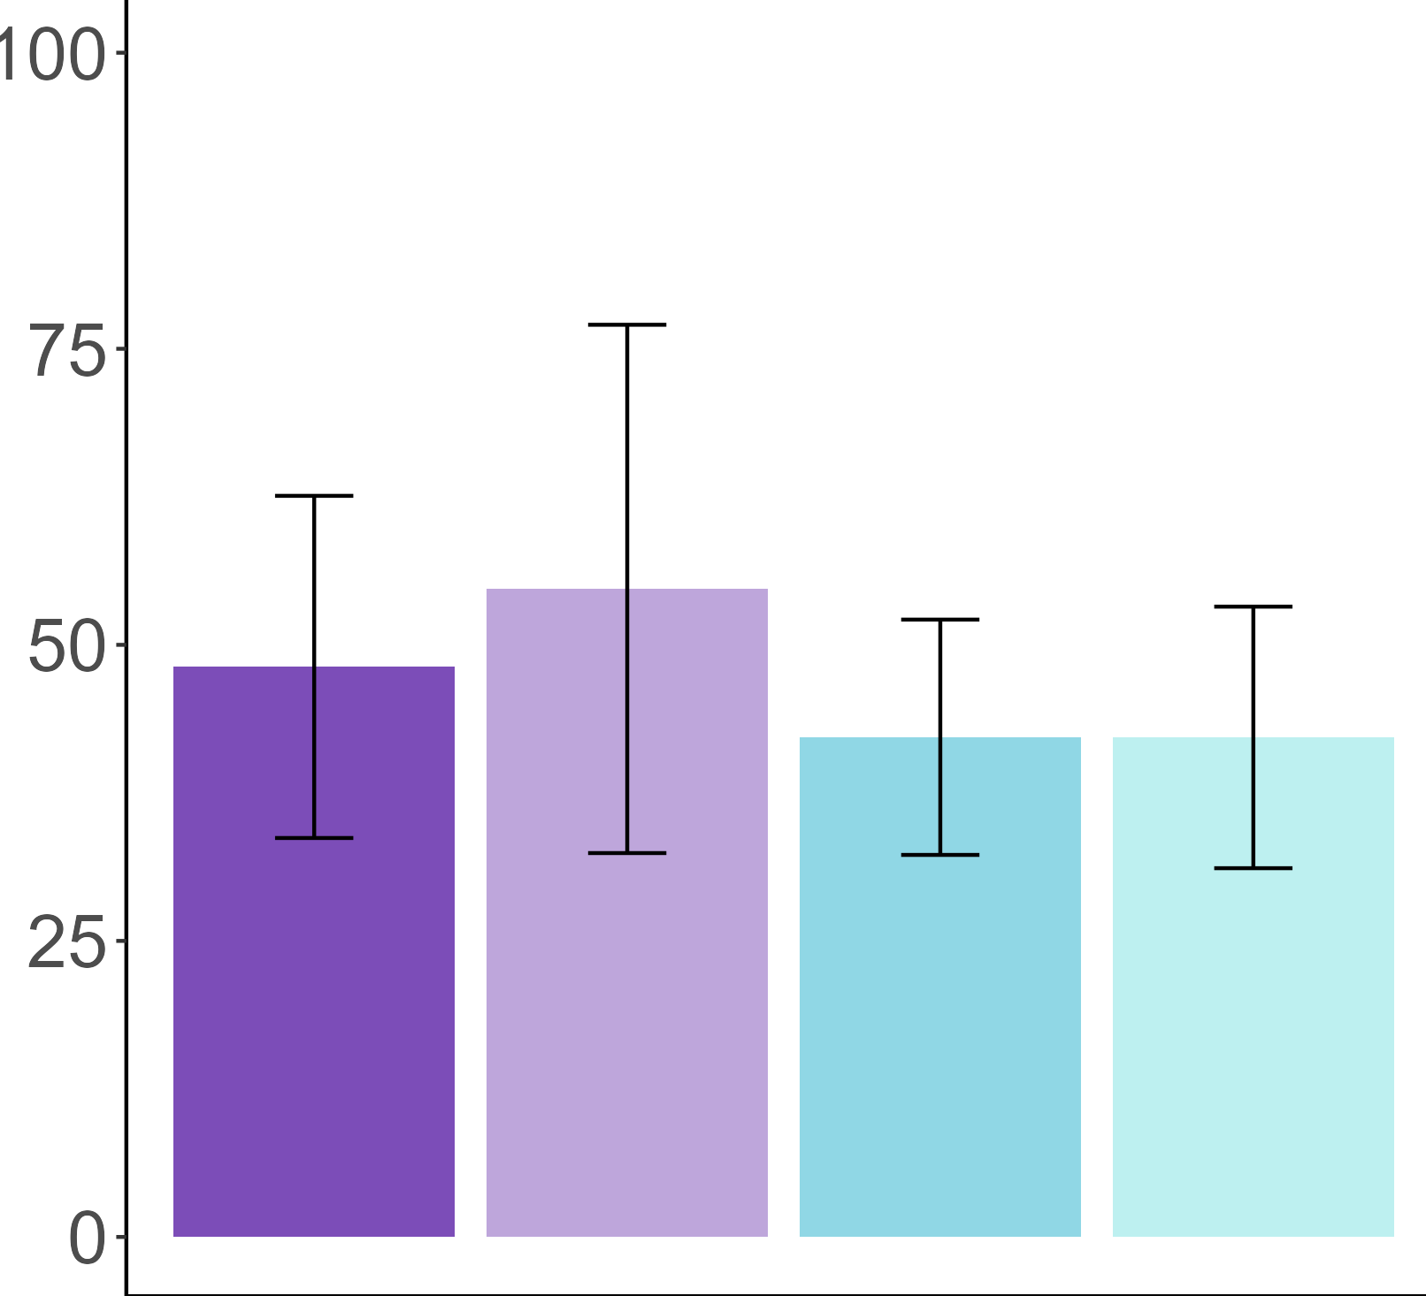
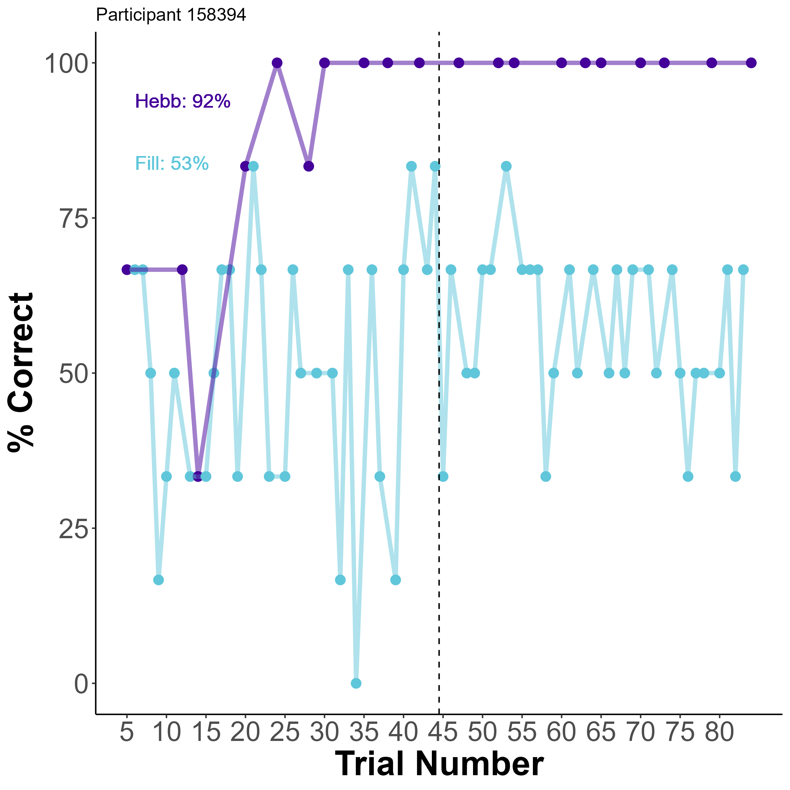
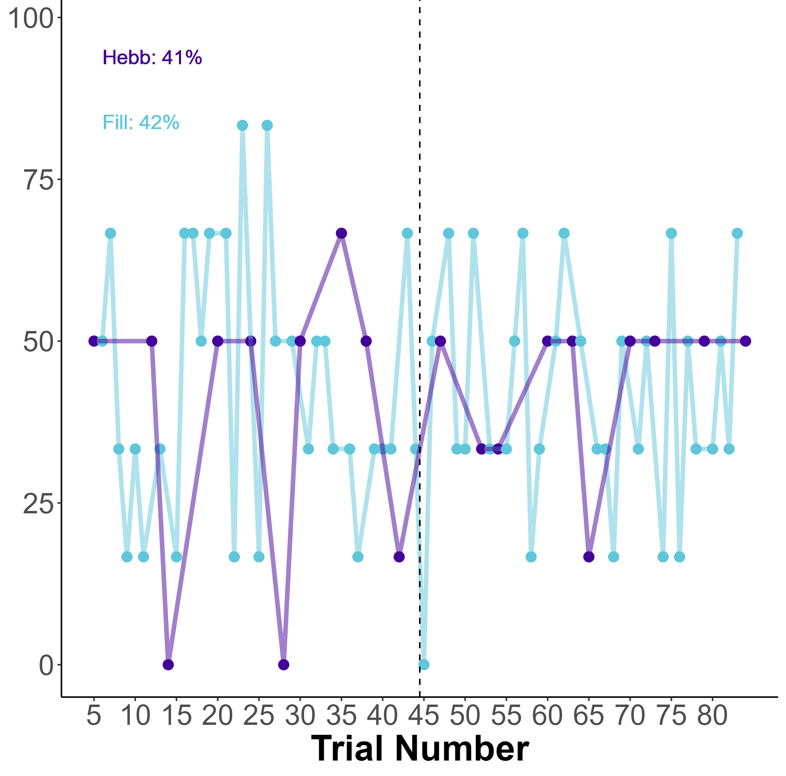
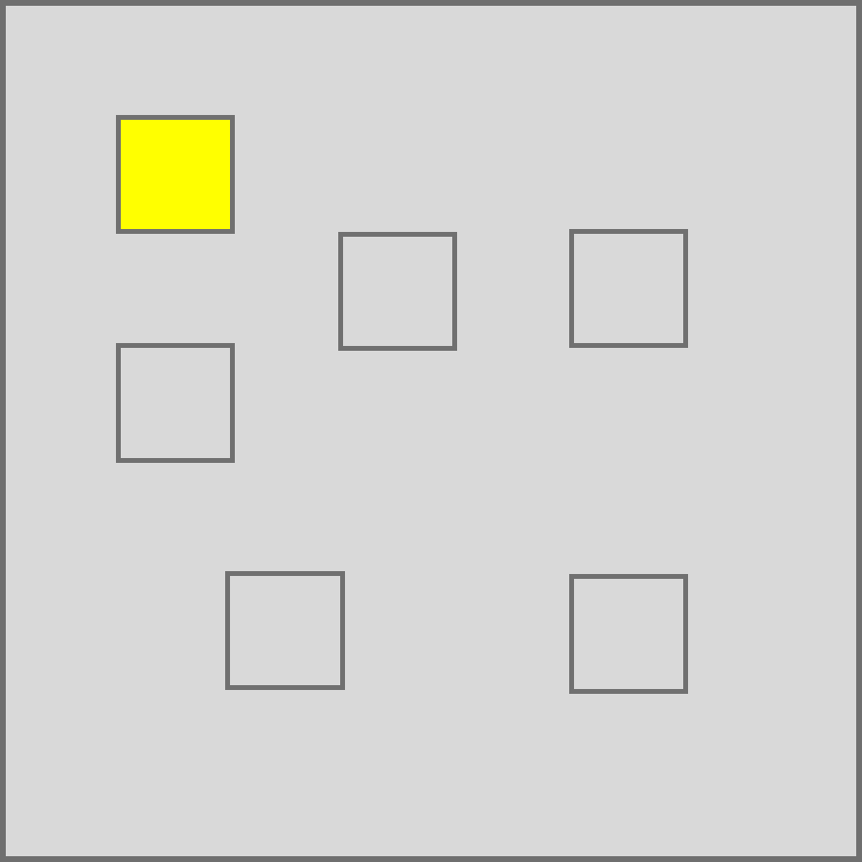
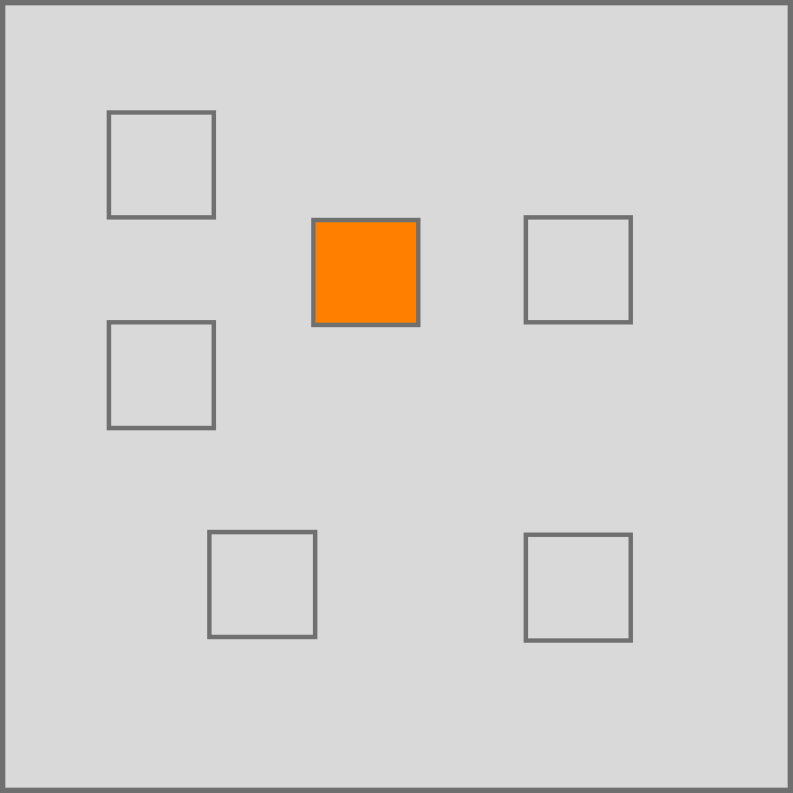
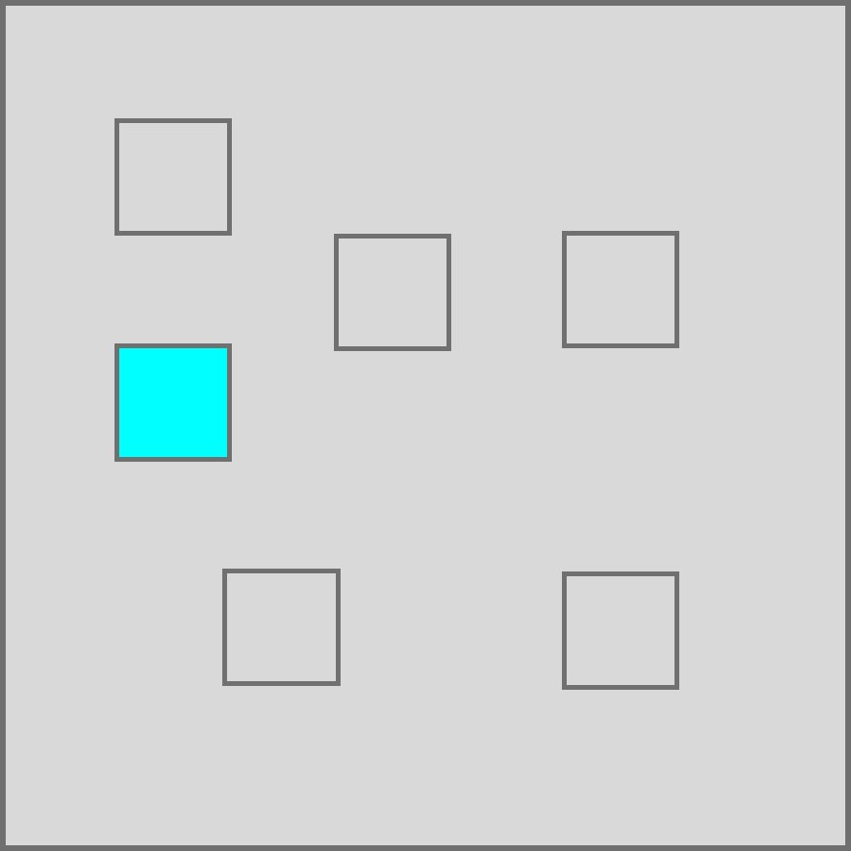
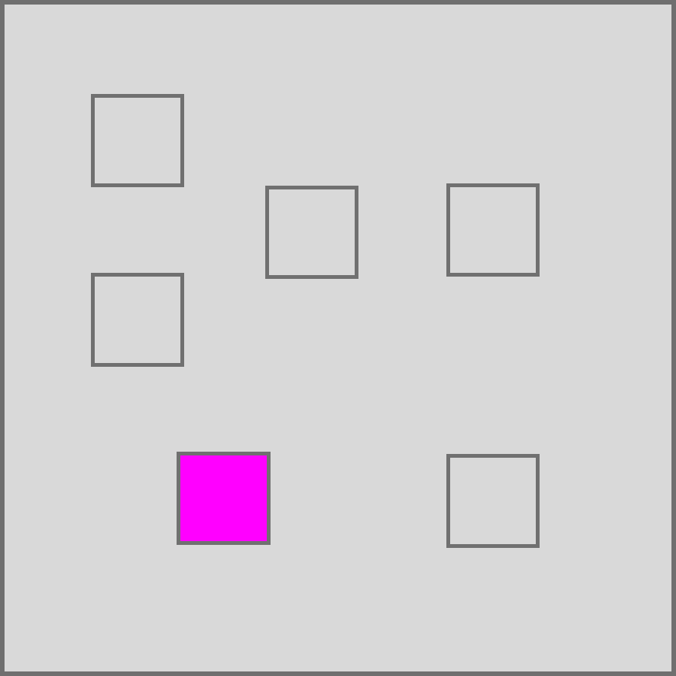
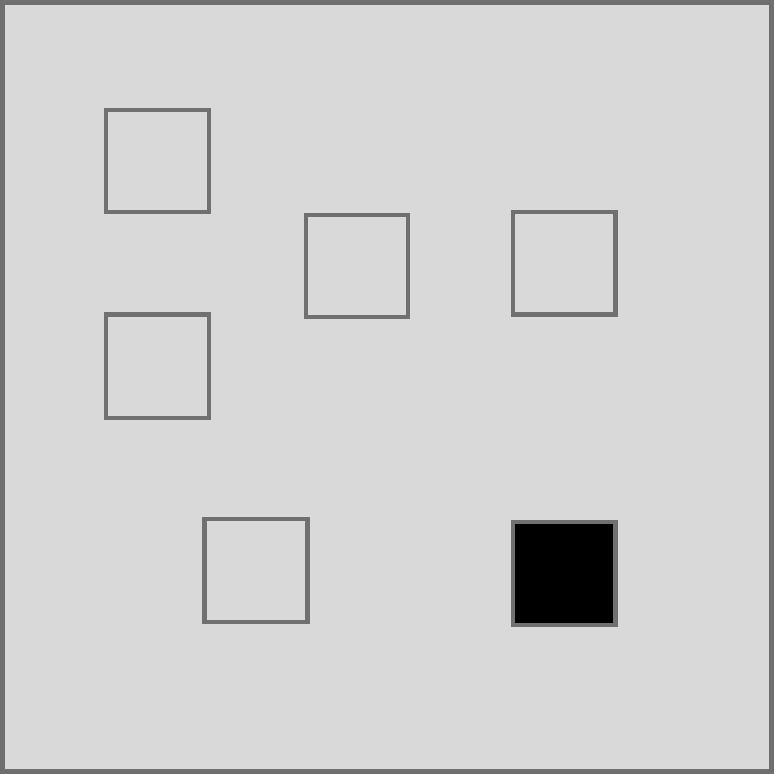
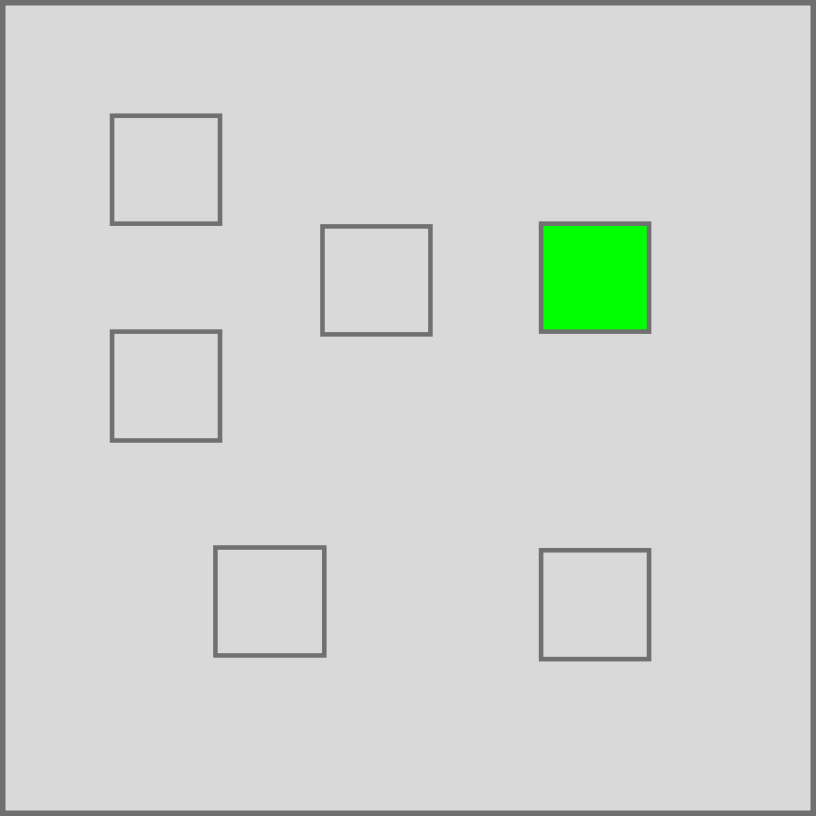
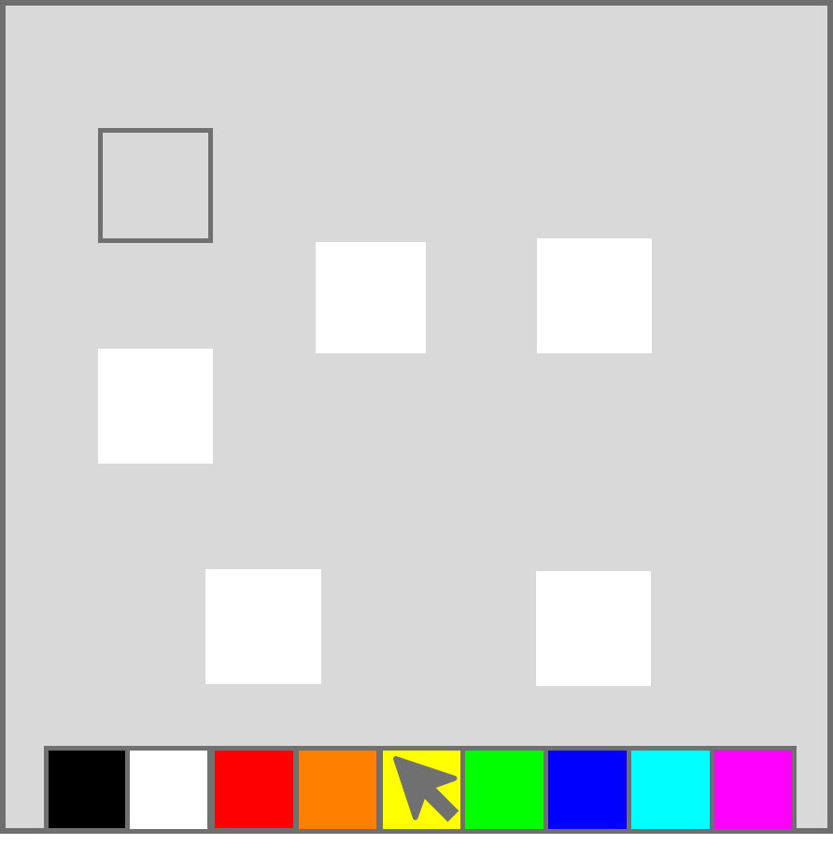
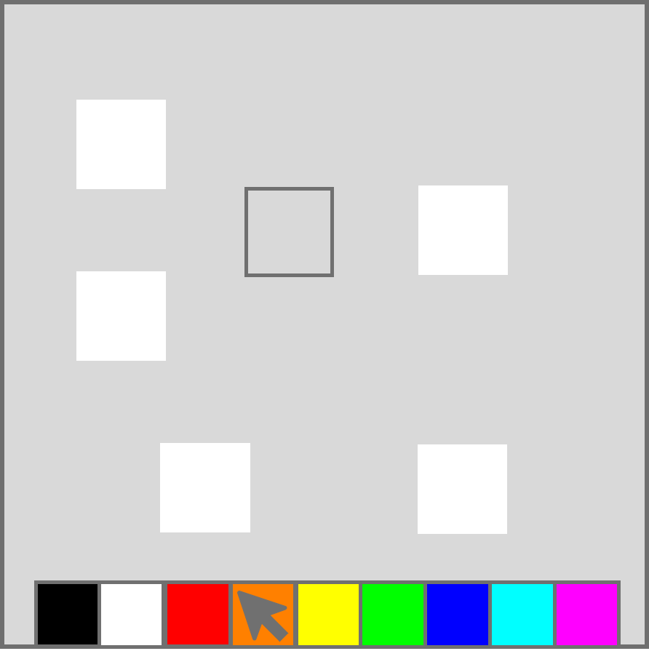
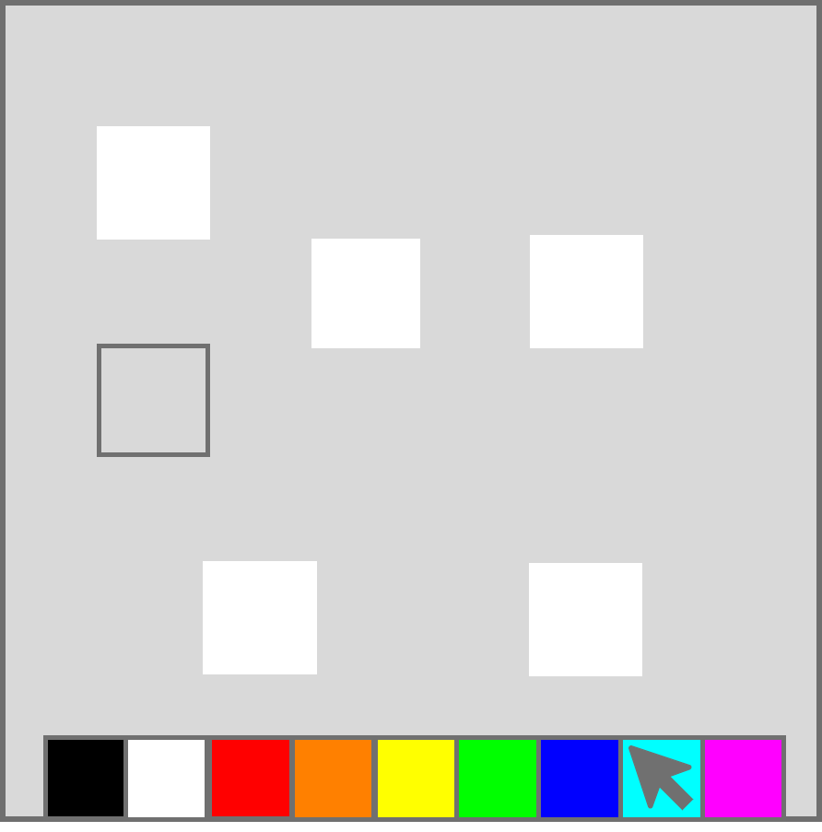
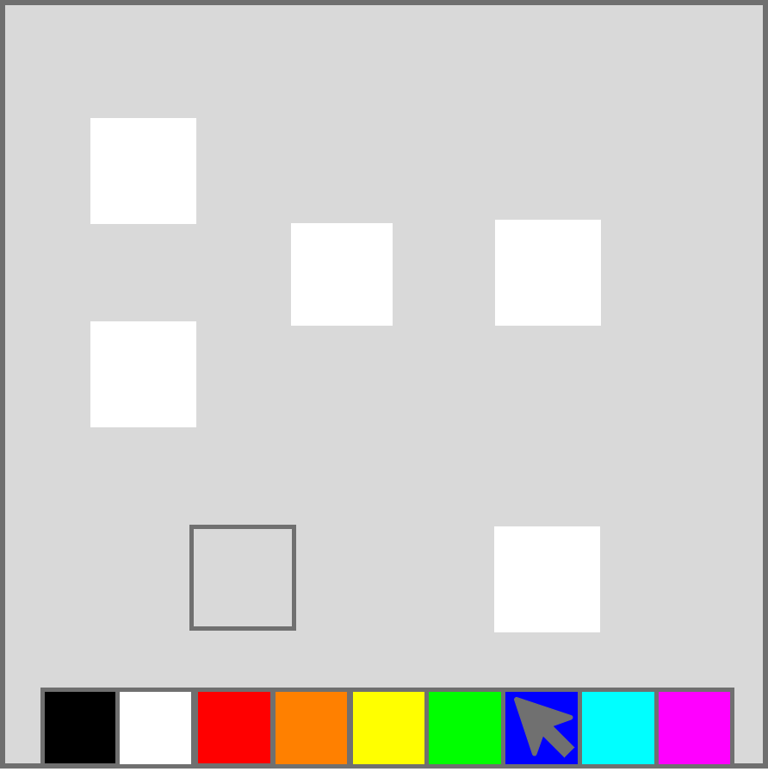
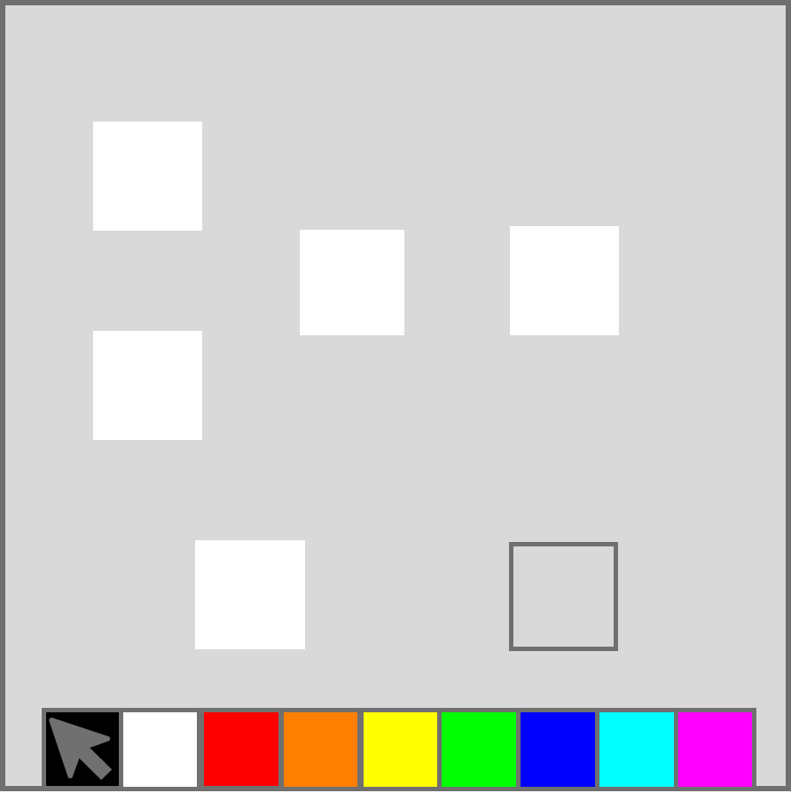
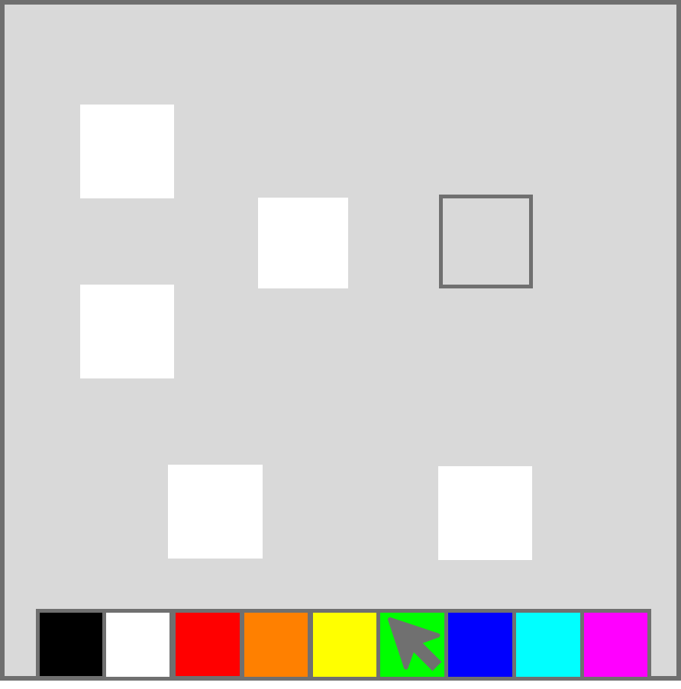
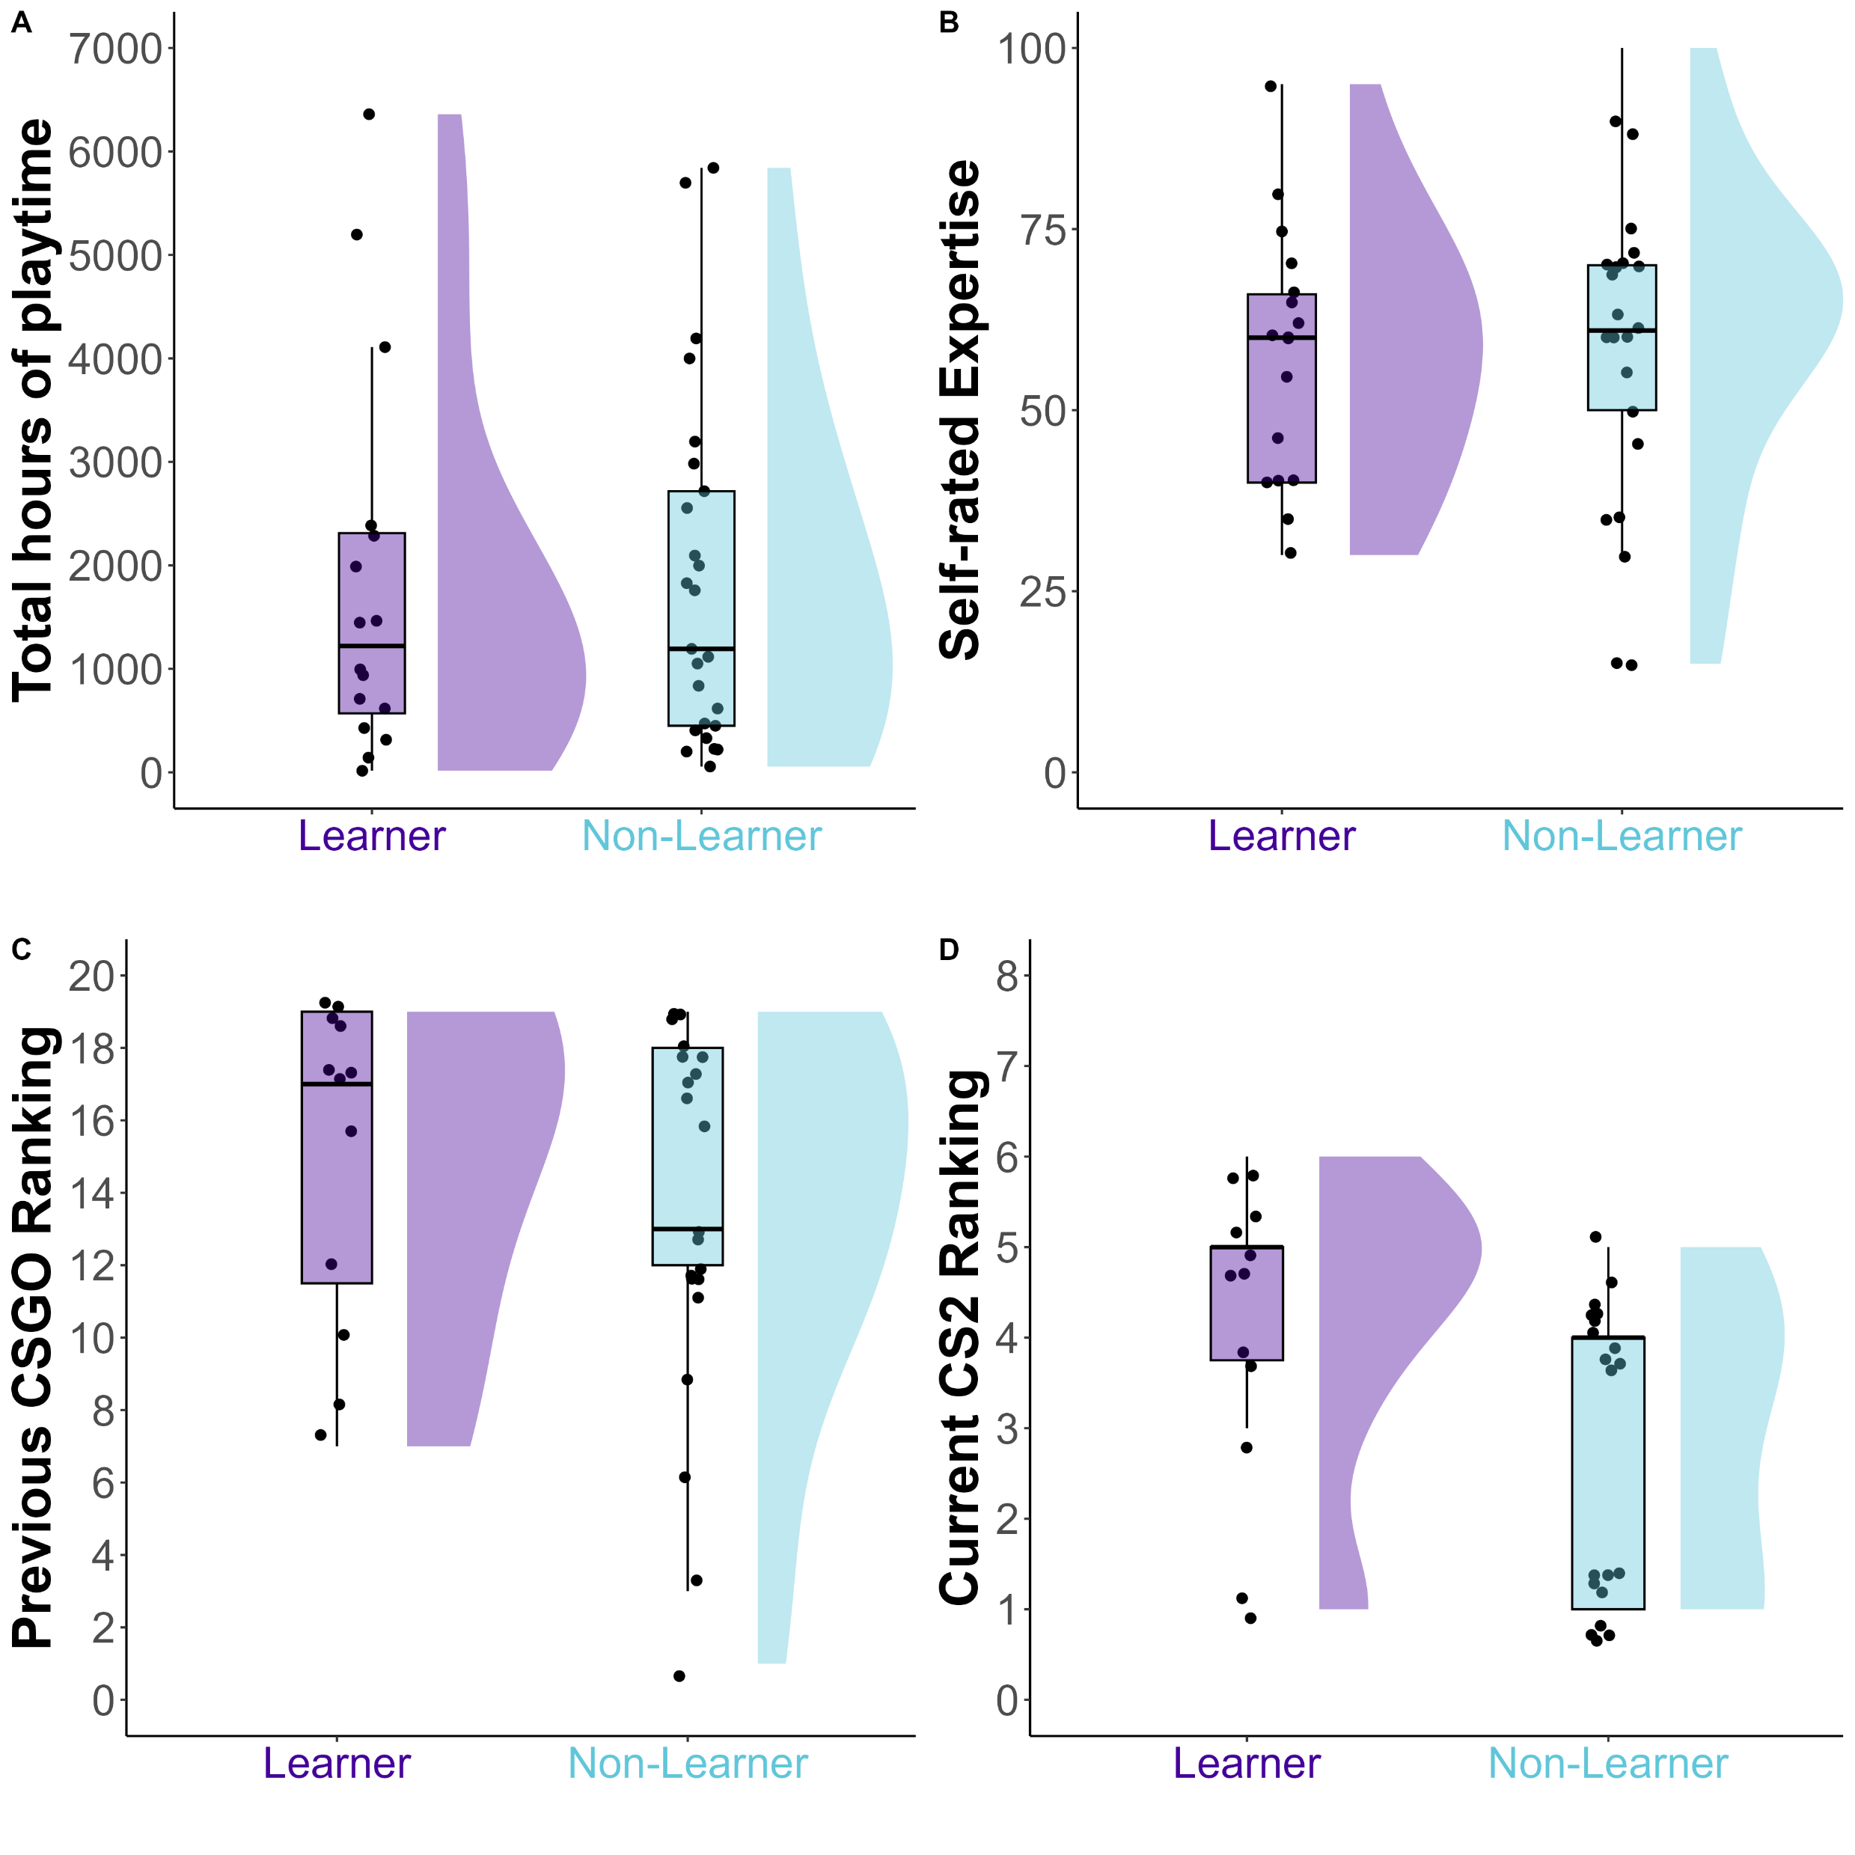
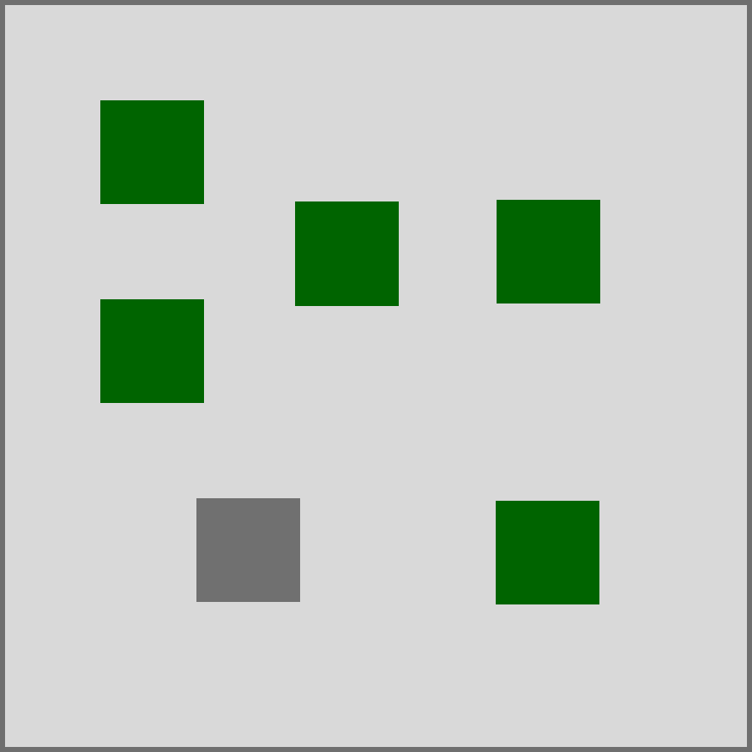

A CROSS-SECTIONAL STUDY OF HEBB-REPETITION LEARNING
IN FIRST-PERSON SHOOTER GAME PLAYERS
Eleanor R. A. Hyde¹, Robert Schmidt², Daniel J. Carroll¹ and Claudia C. von Bastian¹
¹The University of Sheffield (UK),²Ruhr-Universität Bochum (Germany)
BACKGROUND
RESULTS
Video game expertise provides valuable insight into cognitive plasticity within a controlled ‘sandbox’ setting, allowing us to study adaptation to challenging environments through targeted activities.
First-person shooter (FPS) games are fast-paced video games that require quick responses to dynamic situations, potentially involving various cognitive abilities
Previous research shows FPS players to outperform non-video game players in a range of cognitive domains such as perception, attention and spatial ability^{1&2}.
These benefits may arise from enhanced probabilistic inference³ – our ability to make predictions based on statistical patterns and prior knowledge.
Probabilistic inference increases working memory efficiency; by integrating current information with updated past knowledge to make informed predictions⁴.
However, there is limited research investigating probabilistic inference in FPS players - this study examines the association between expertise in the FPS game Counter-Strike 2 (CS2) and learning in a visuospatial Hebb-repetition task.
Overall, participants showed greater accuracy on Hebb compared to Filler trials. Participants also showed an improvement in accuracy in Block 2 of the Hebb trials.
Statistical tests of differences between Hebb and Filler accuracy per participant revealed N = 17 Learners and N = 25 Non-Learners.
Mean accuracy across participants
% Correct
Block 1 Hebb
Block 2 Hebb
Block 1 Fill
Block 2 Fill
Accuracy across trials for a Learner and Non-Learner participant
Preliminary tests show a significant difference between Learners and Non-Learners Counter-Strike 2 matchmaking ranking.
Counter-Strike Expertise of Learners and Non-learners
NEXT STEPS: Collect more data and conduct a k-means cluster analysis of Counter-Strike expertise in Learners and Non-Learners.
Learner accuracy: p <.001, BF > 1000
Non-Learner accuracy: p = .790, BF = 0.32
METHOD
VISUOSPATIAL HEBB-REPETITION TASK⁵
Participants were presented with sequences of six coloured squares (for 200ms each) at differing locations in a grid, which they must immediately recall. Unbeknownst to them, one HEBB sequence is, on average, repeated every fourth trial, while other FILLER sequences are not repeated.
COUNTER-STRIKE EXPERTISE QUESTIONNAIRE
Total hours of playtime
Fortnightly hours of playtime
Self-rated expertise
Current in-game ranking
H1: The typically observed memory benefits for Hebb sequences will be more pronounced with higher Counter-Strike expertise.
200ms
200ms
200ms
200ms
200ms
200ms
Presentation Phase
Recall Phase
p =.542, BF = 0.37
p =.749 , BF = 0.32
Feedback Phase
1500ms
p =.374, BF = 0.45
p =.035, BF = 2.23
PARTICIPANTS
TAKE HOME MESSAGE
42 participants aged 17 – 38 years (M = 25.31, SD = 5.52) were recruited online. Participants were mostly male (35) from the United Kingdom (35), identified ethnically as White (36), varied in their education from 12 – 24 years (M = 16.14, SD = 2.93), and self-rated socioeconomic status (SES), on a scale from 1-10, from 3-8 (M = 5.81, SD = 1.53).
Establishing cross-sectional FPS expertise benefits in probabilistic inference could inform training programs for professionals who require quick, accurate decisions under pressure (paramedics, surgeons, and air traffic controllers). However, more data collection is required as preliminary evidence is too ambiguous to draw conclusions.
REFERENCES
1. Bediou, B., Adams, D. M., Mayer, R. E., Tipton, E., Green, C. S., & Bavelier, D. (2018). Meta-analysis of action video game impact on perceptual, attentional, and cognitive skills. Psychological bulletin, 144(1), 77–110. https://doi.org/10.1037/bul0000130
2. Bediou, B., Rodgers, M. A., Tipton, E., Mayer, R. E., Green, C. S., & Bavelier, D. (2023). Effects of Action Video Game Play on Cognitive Skills: A Meta-Analysis. Technology, Mind, and Behavior, 4(1: Spring 2023). https://doi.org/10.1037/TMB0000102
3. Bavelier, D., Green, C. S., Pouget, A., & Schrater, P. (2012). Brain plasticity through the life span: learning to learn and action video games. Annual review of neuroscience, 35, 391–416. https://doi.org/10.1146/annurev-neuro-060909-152832
4. Brady, T. F., & Tenenbaum, J. B. (2013). A probabilistic model of visual working memory: Incorporating higher order regularities into working memory capacity estimates. Psychological review, 120(1), 85-109. https://psycnet.apa.org/doi/10.1037/a0030779 5. Musfeld, P., Souza, A. S., & Oberauer, K. (2023). Repetition learning is neither a continuous nor an implicit process. Proceedings of the National Academy of Sciences of the United States of America, 120(16), e2218042120. https://doi.org/10.1073/pnas.2218042120

